Slide 1
What are the most accurate Forecast for Electric Production for next 10 Months.
Ajay Krishnan Jayakumar Usha (S3886508) Joyal Joy Madeckal (S3860476) Kavya Kondapalli (S3838465)

Slide 2
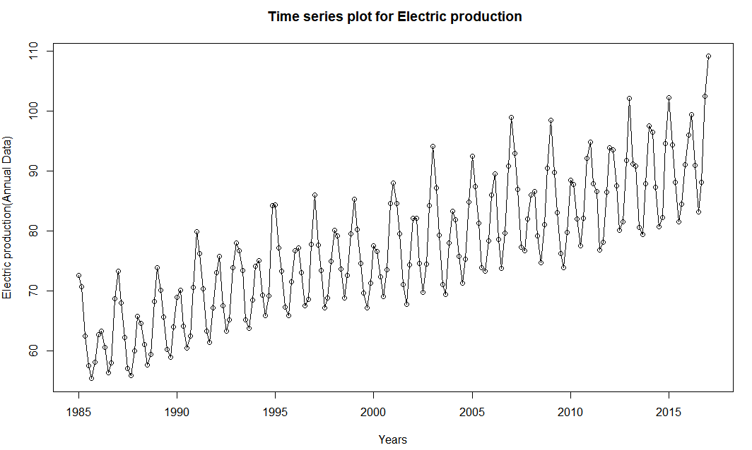
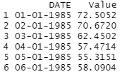
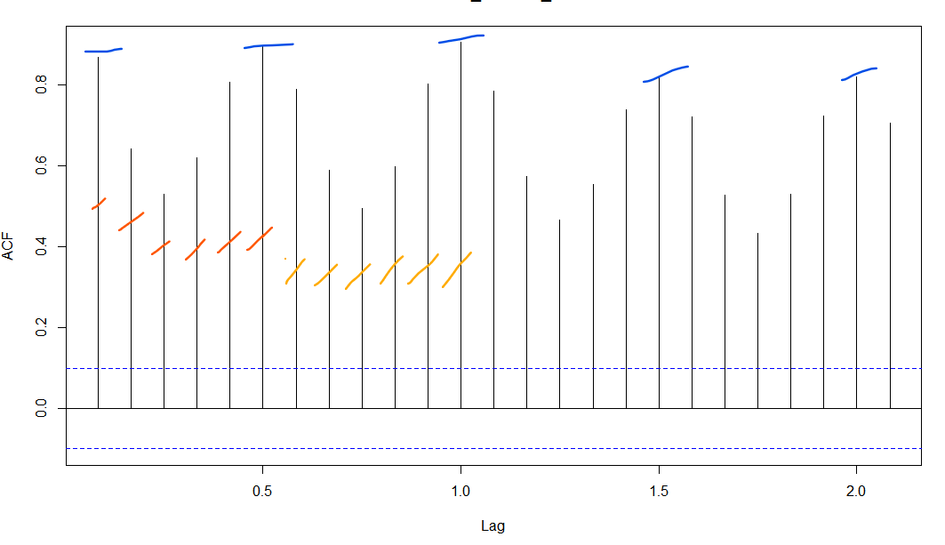
Summary
We set the Frequency to 6 after observing the seasonality.

Slide 3
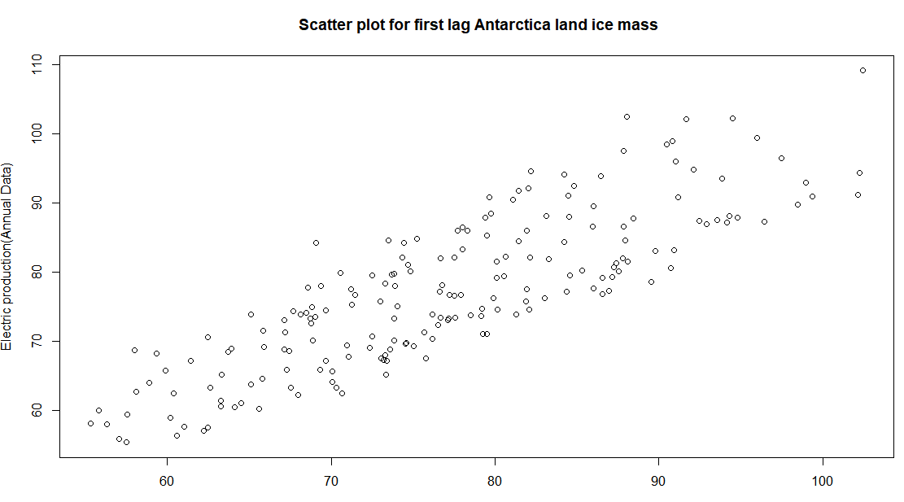
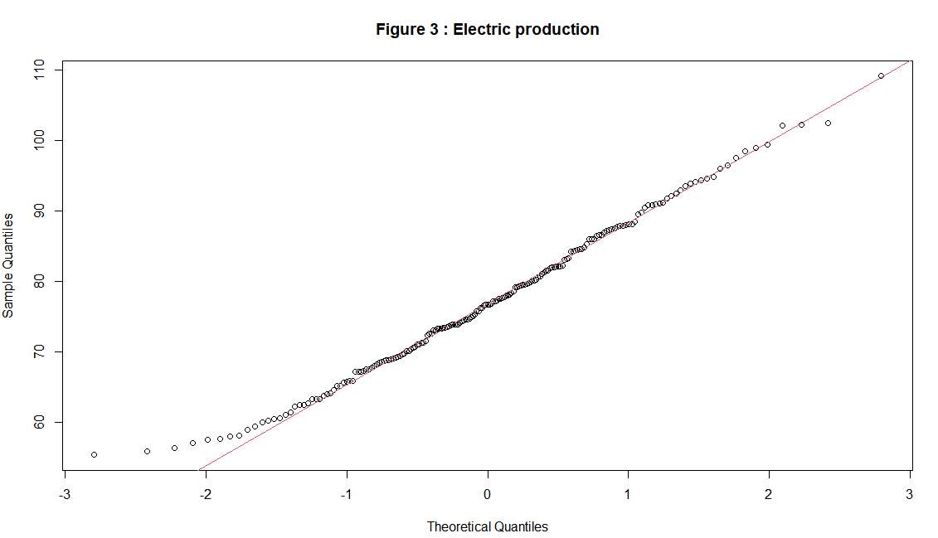
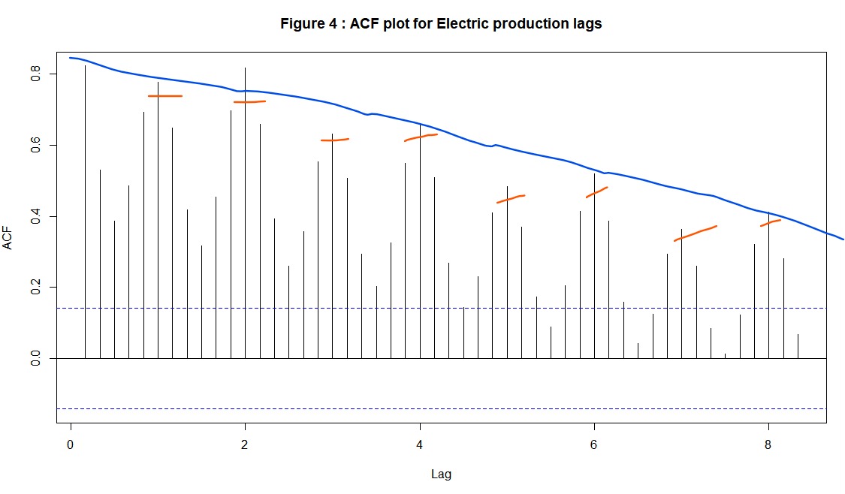
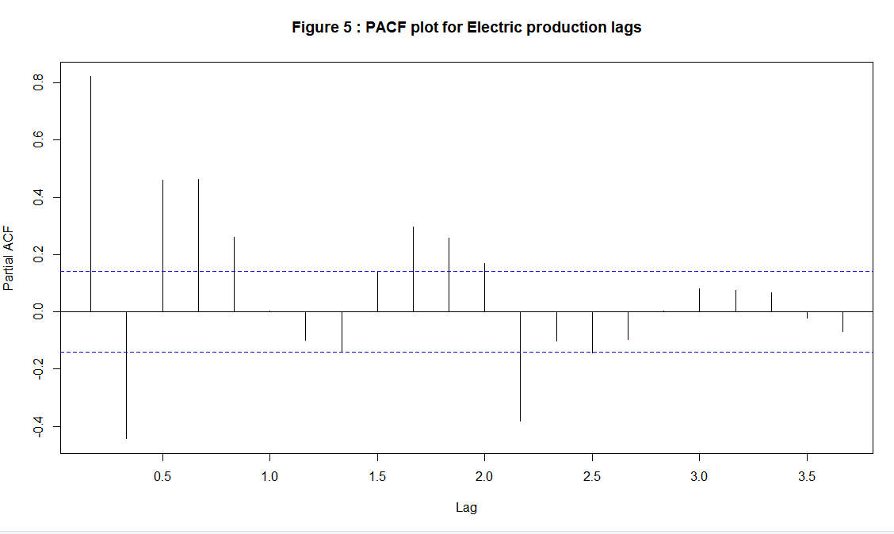
Shapiro Wilk
p-value = 0.1854
Correlation: 0.8407213

Slide 4
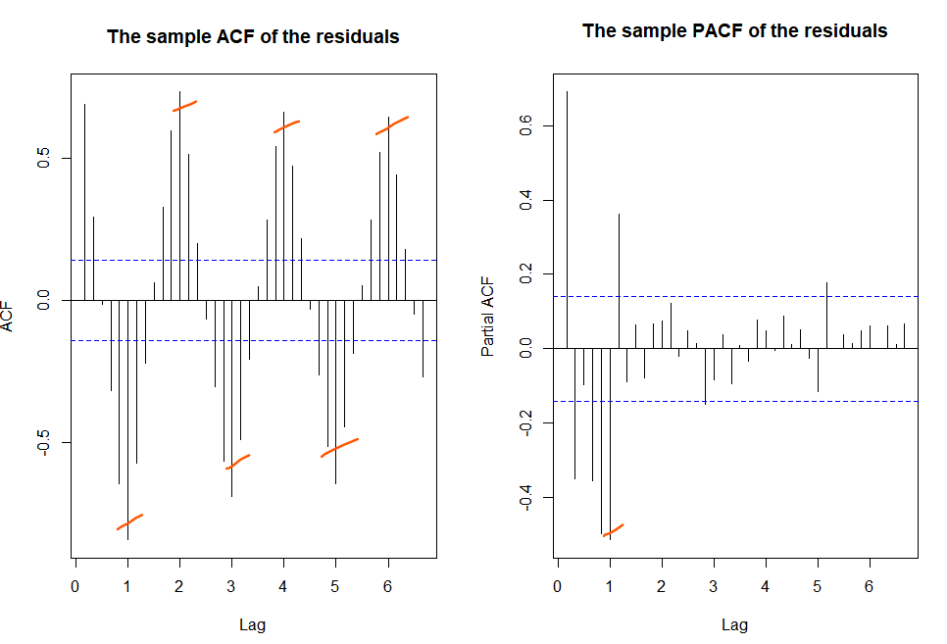
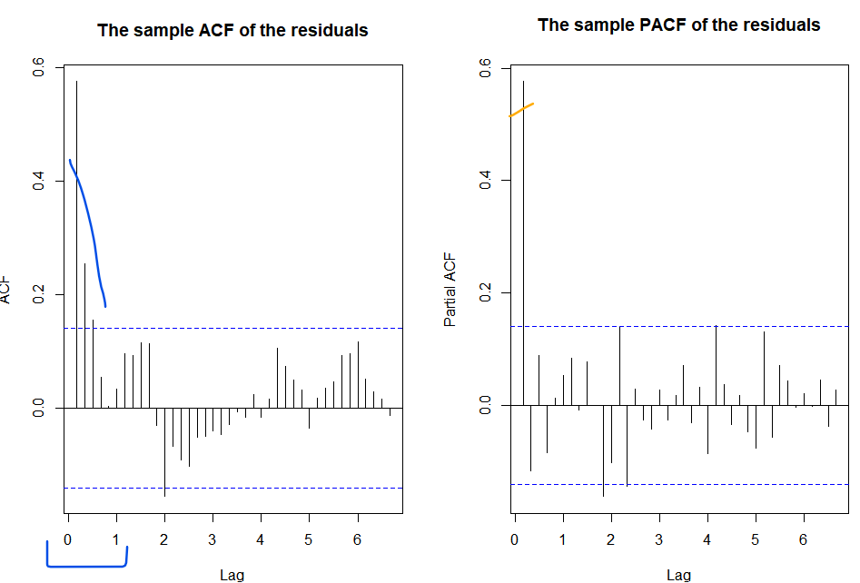
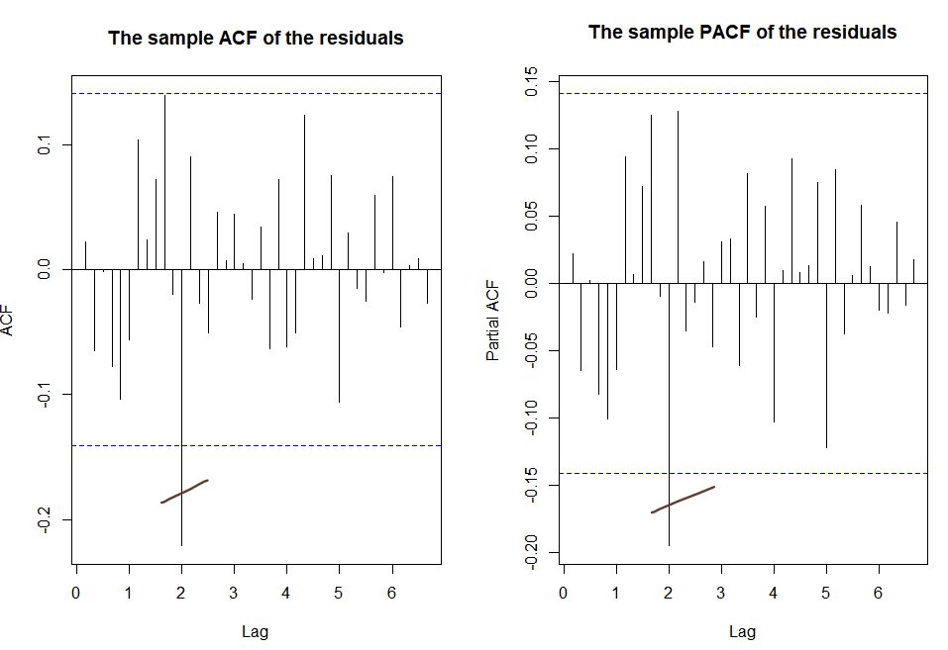
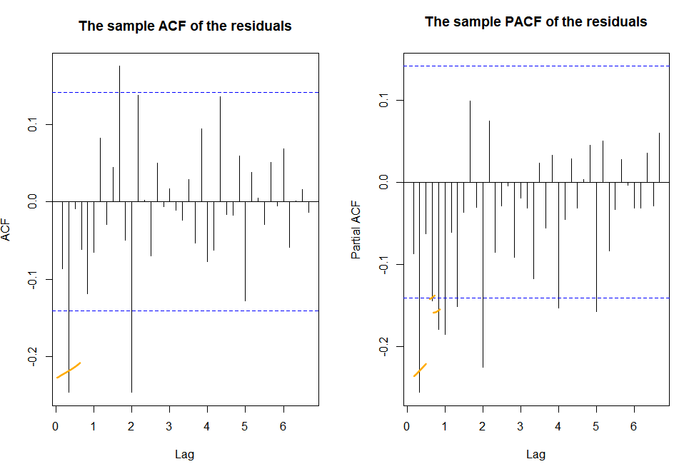
D=1
P=1, D=1,Q=0
P=1, D=1,Q=0 p=3,d=1,q=1
P=1, D=1,Q=0 , d=1
SARIMA(3,1,1)x(1,1,0)_6

Slide 5
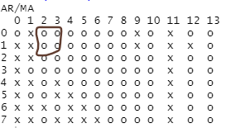
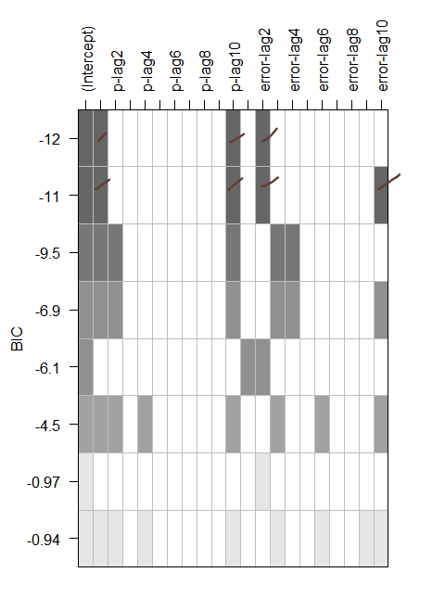
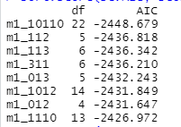
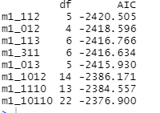
# The tentative models from eacf are specified as
# SARIMA(0,1,2)x(1,1,0)_6
# SARIMA(0,1,3)x(1,1,0)_6
# SARIMA(1,1,2)x(1,1,0)_6
# SARIMA(1,1,3)x(1,1,0)_6
# The tentative models from BIC are specified as
# SARIMA(1,1,2)x(1,1,0)_6
# SARIMA(10,1,2)x(1,1,0)_6
# SARIMA(1,1,10)x(1,1,0)_6
# SARIMA(10,1,10)x(1,1,0)_6
AIC
BIC

Slide 6
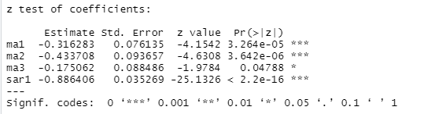
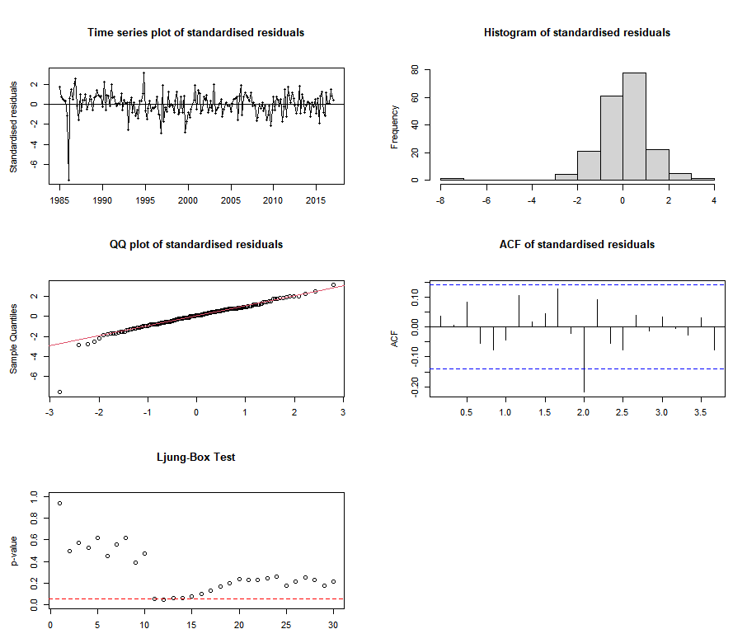
Total Set of Models from ACF/PACF, Eacf & BIC Table
# SARIMA(3,1,1)x(1,1,0)_6
# SARIMA(0,1,2)x(1,1,0)_6
# SARIMA(0,1,3)x(1,1,0)_6
# SARIMA(1,1,2)x(1,1,0)_6
# SARIMA(1,1,3)x(1,1,0)_6
# SARIMA(10,1,2)x(1,1,0)_6
# SARIMA(1,1,10)x(1,1,0)_6
# SARIMA(10,1,10)x(1,1,0)_6
Significant Coefficient & Good Residual
# SARIMA(0,1,2)x(1,1,0)_6
# SARIMA(0,1,3)x(1,1,0)_6
# SARIMA(1,1,3)x(1,1,0)_6
# SARIMA(10,1,10)x(1,1,0)_6
SARIMA(0,1,3)x(1,1,0)_6

Slide 7
